Slide 1

Team “Apple”
Quality Assurance
Team Project
September / November, 2014

Slide 2
Team Members
Kiril Todorov (@ kirilt7)
Mladen Mladenov (@ MlaDANCe)
Stanislav Iliev (@ Termininja)
Svetlin Nyagolov (@ tinskiwe)
Valerya Dimitrova (@ VDimitrova)
Vanina Nenova (@ ms-nenova)

Slide 3
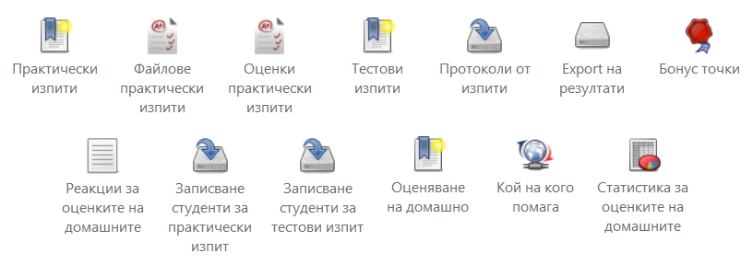
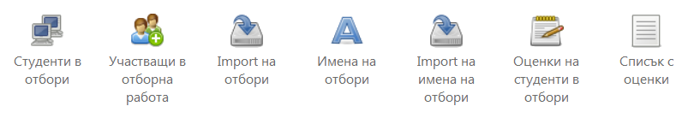
Telerik Academy Learning System
Evaluation modules
Teamwork modules

Slide 4
Statistics
Total Test Cases - 319
  Passed : 242
  Failed : 77
Automated tests
  Telerik Test Studio : 145
  Telerik Testing Framework : 140
Bugs
  Logged: 53
  Fixed: 1

Slide 5
History
Week 3: Test Plan
Week 4: Test Case Management
Week 5: Test Automation
Week 6: Test Automation
Week 7: Test Automation
Week 8: Test Automation
Week 9: Performance Testing
Week 10: Regression Testing

Slide 6
Source Control System
GitHub: https://github.com/QATeamApple
Repositories:
  Documents
  TelerikTestStudioTests
  TelerikAcademyAutomatedTests
  PerformanceTests
Commits: ~250

Slide 7
Documentation
Test Plan
Performance Test Plan
Requirements

Slide 8
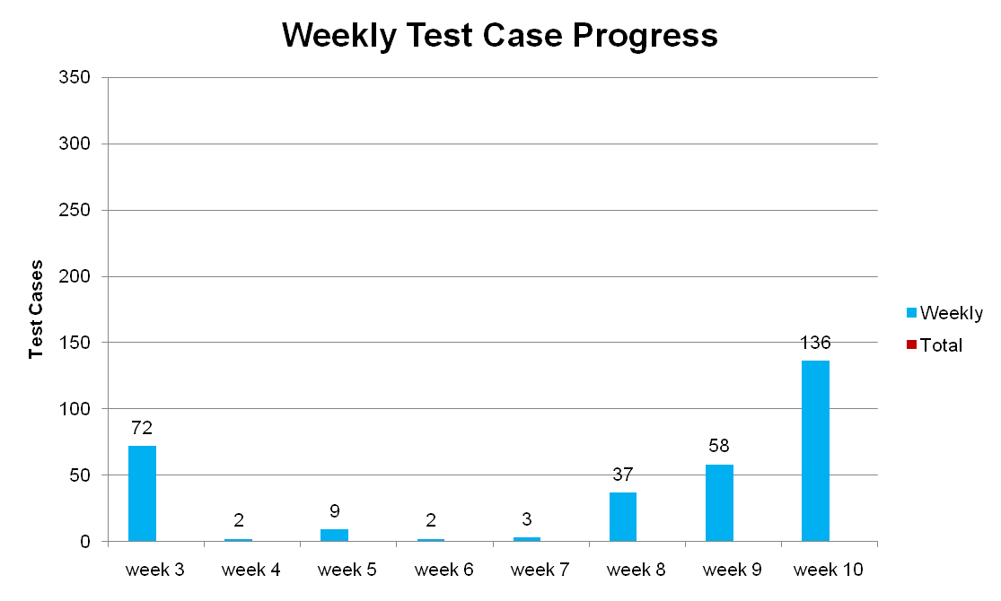
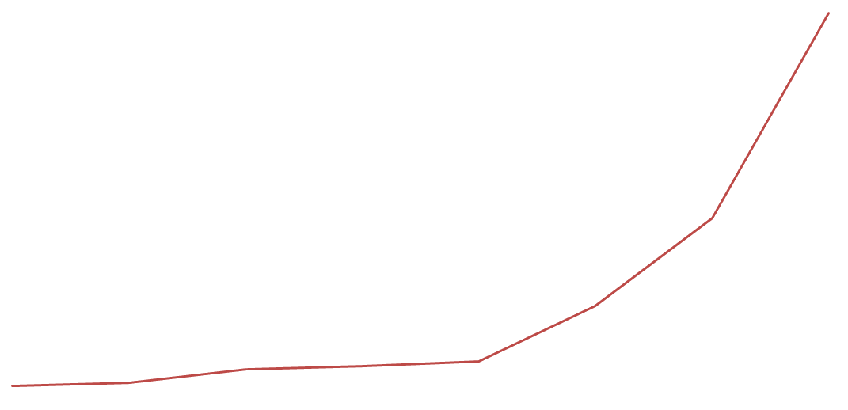
Test Cases

Slide 9
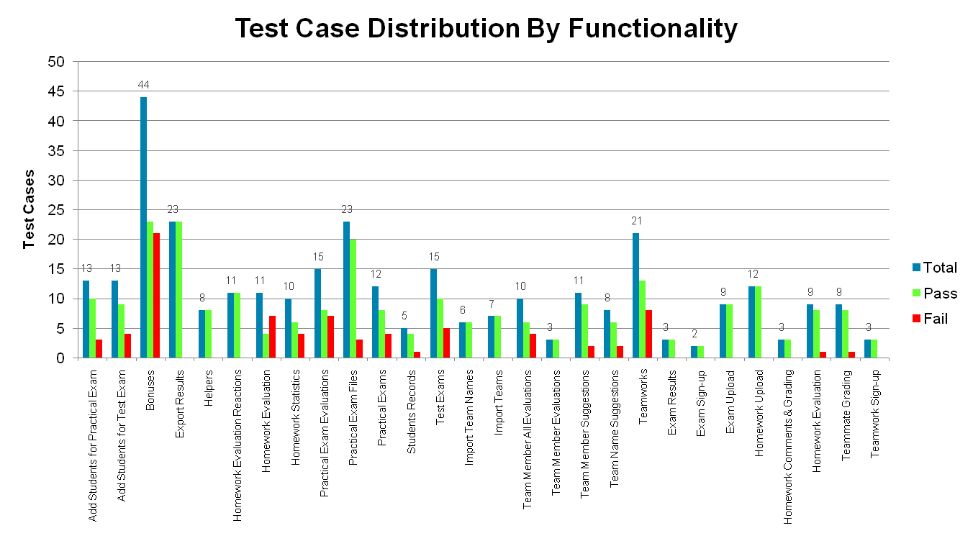
Test Cases

Slide 10
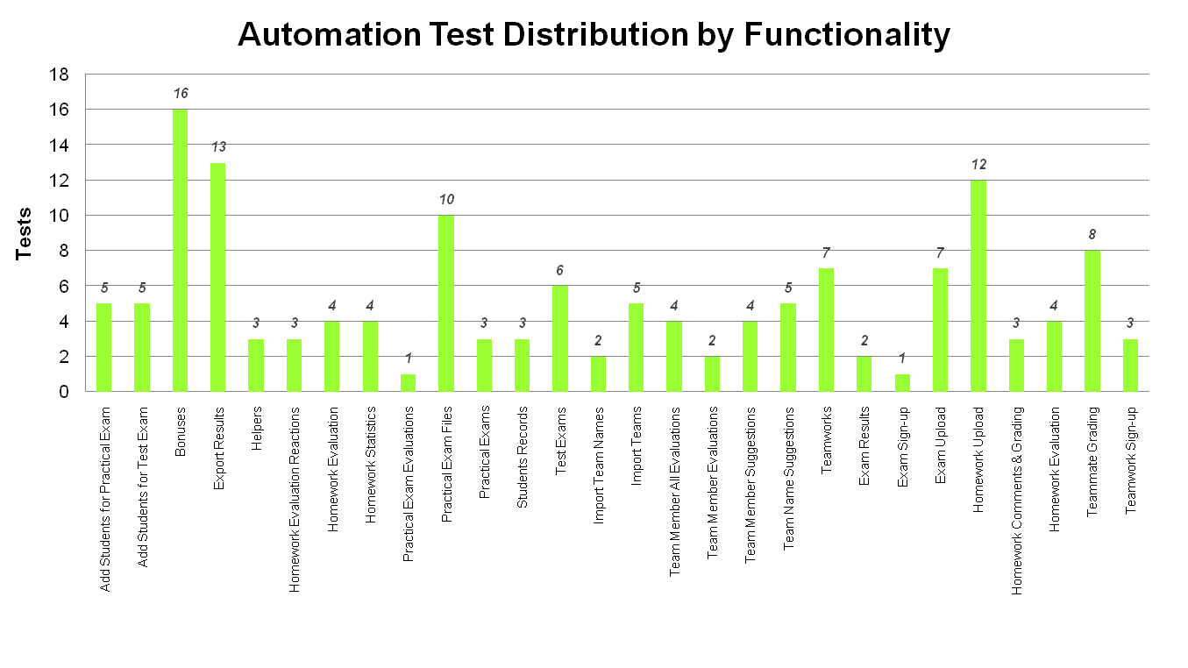
Test Studio Automation
Admin UI
Front-end UI

Slide 11
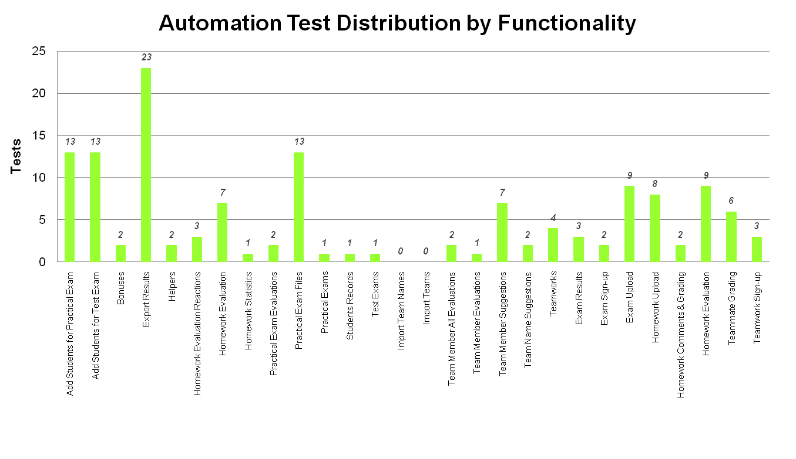
TTF Automation
Admin UI
Front-end UI

Slide 12
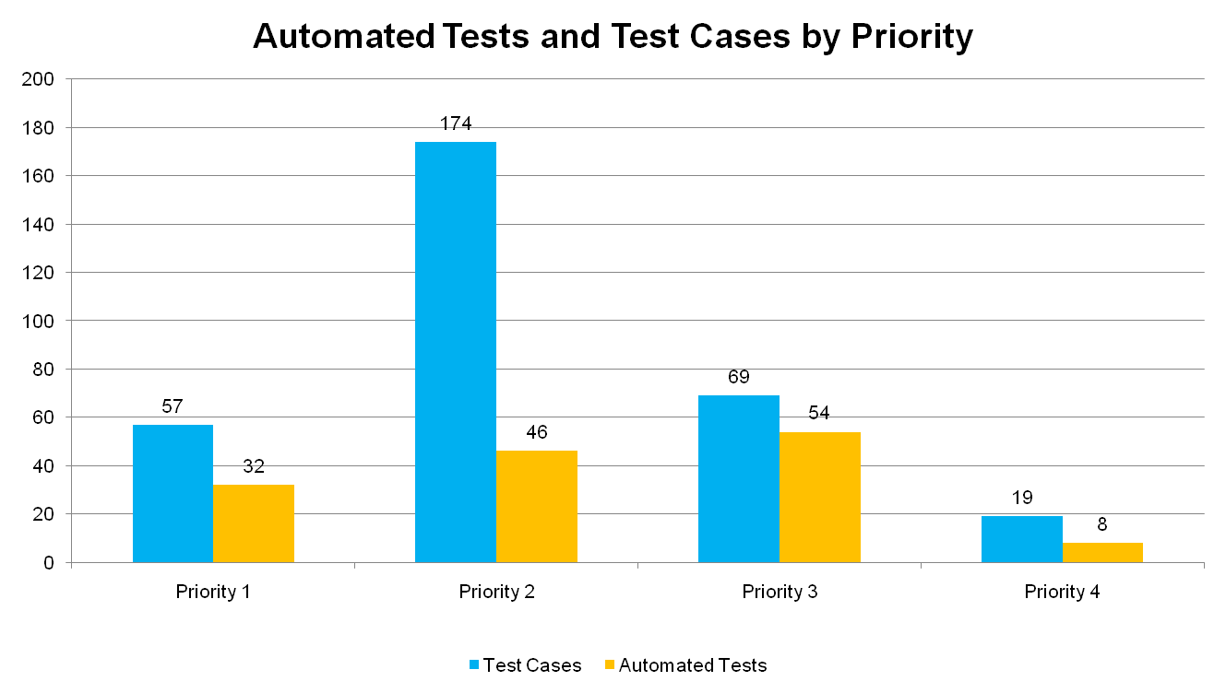
TTF Automation

Slide 13
Regression Testing
Before regression: 7 failed
After regression: 16 failed
Fixed: 6
Not fixed: 3
Result: 10 failed

Slide 14
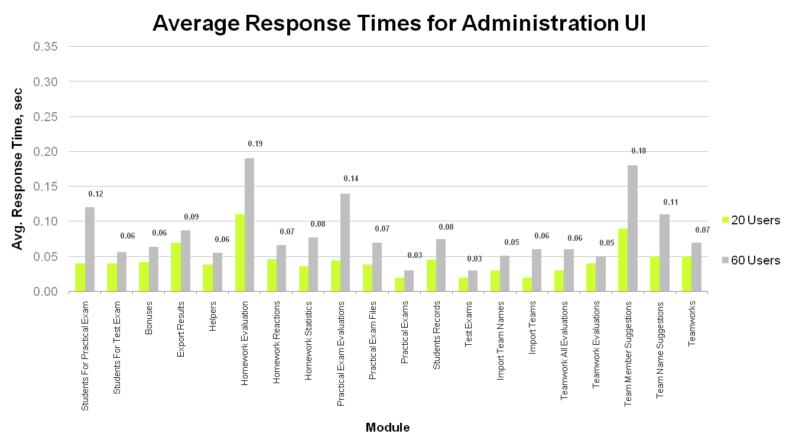
Performance, Load & Stress Testing
Pass criteria

Slide 15
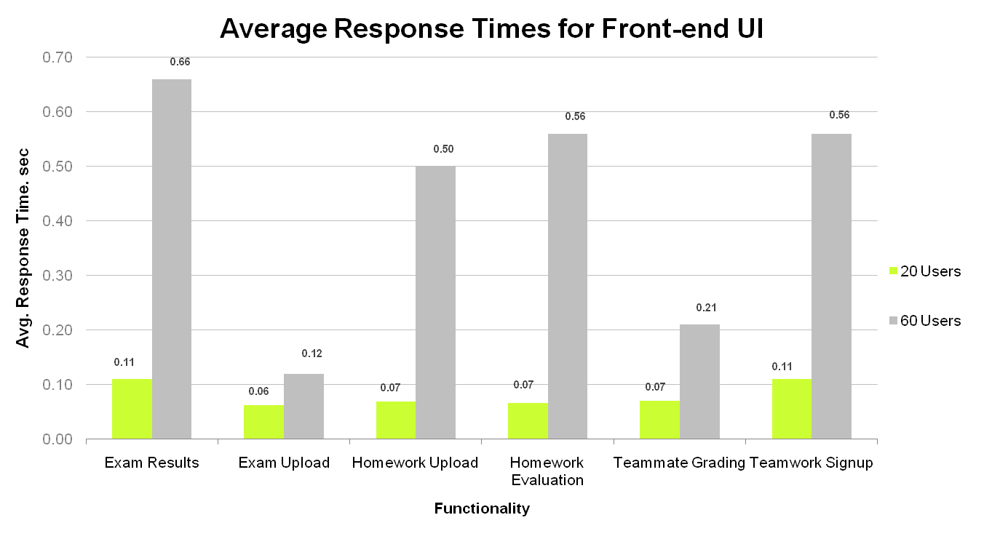
Performance, Load & Stress Testing
Pass criteria

Slide 16
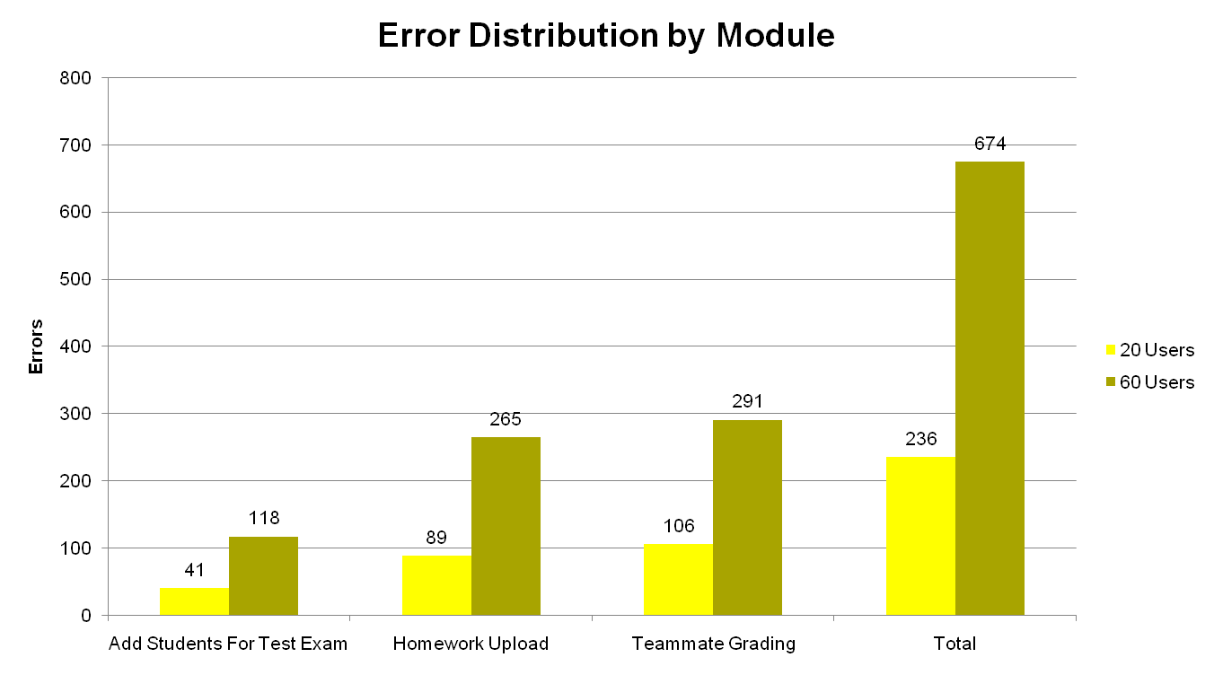
Performance, Load & Stress Testing

Slide 17
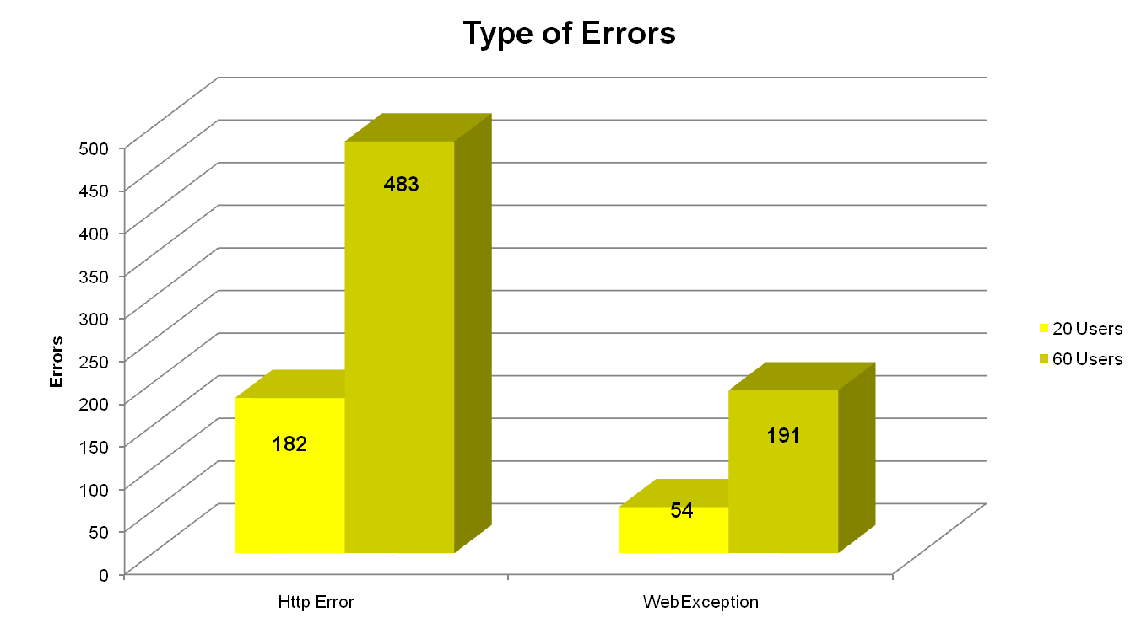
Performance, Load & Stress Testing

Slide 18
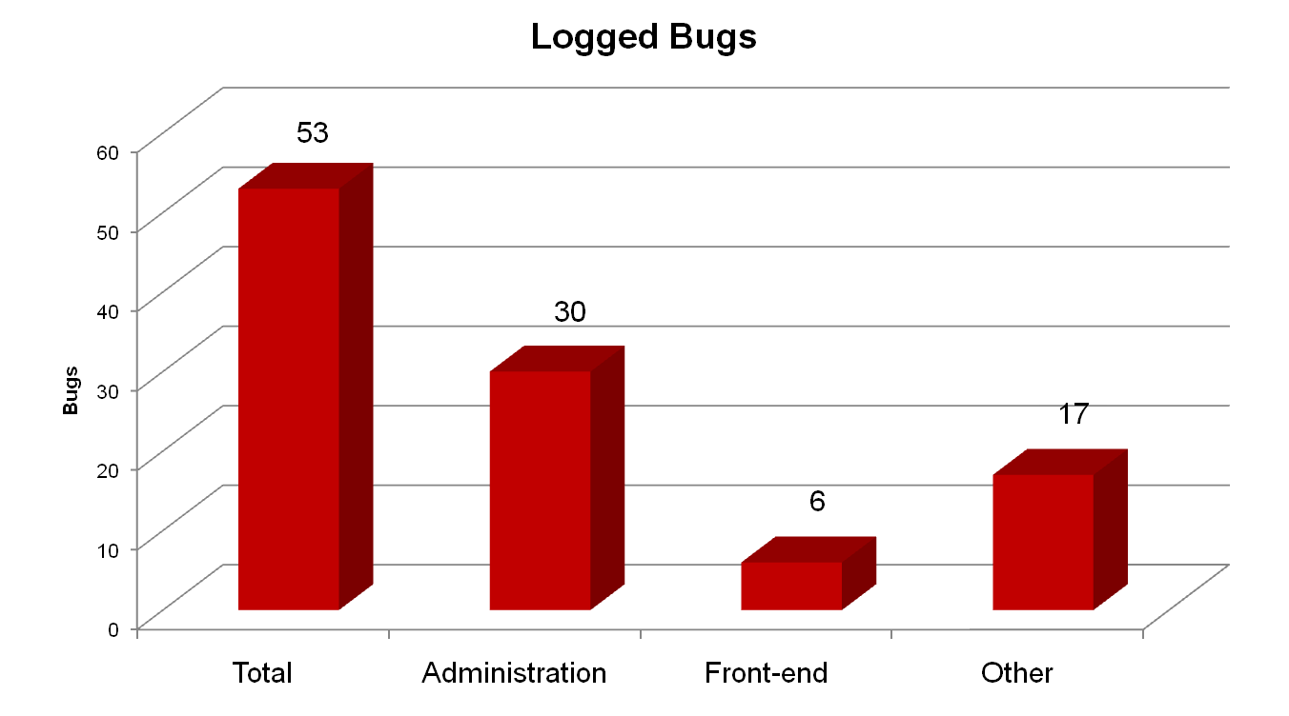
Bugs

Slide 19
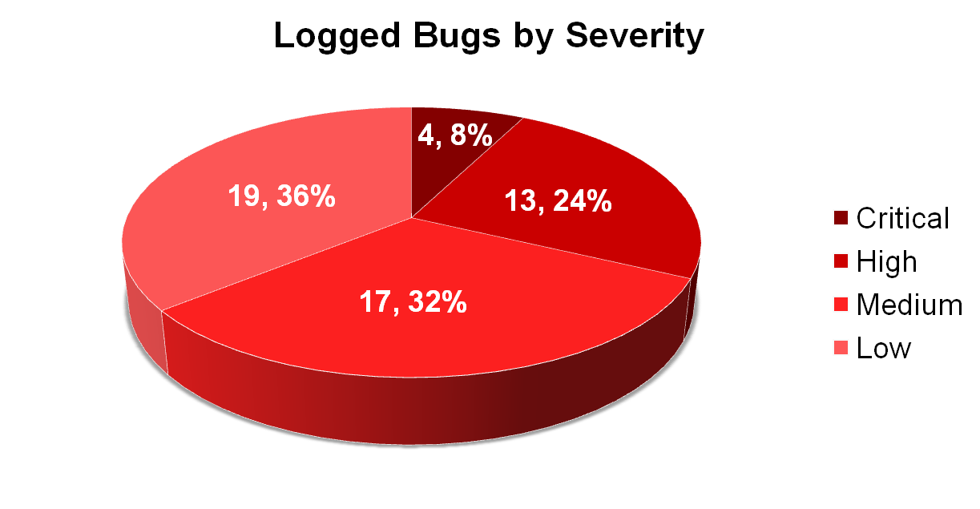
Bugs

Slide 20
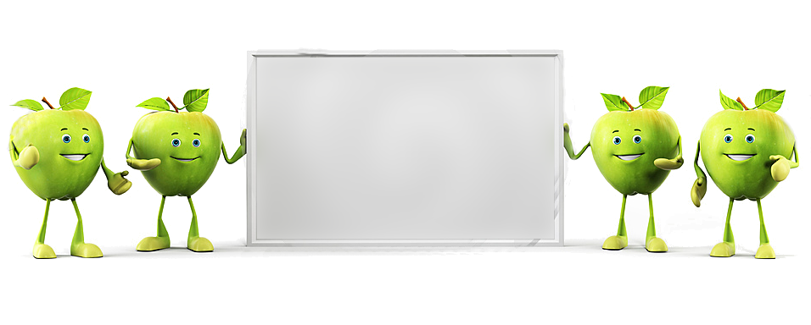
Thank
You

